Slide 1

JOB LOCATION SUGGESTION USING MACHINE LEARNING
Group 3 - Model Builders
Aswini Pusuluri, Gianni Deguzman , Sowmya Ravichandran, Vishalakshi Ramanathan

Slide 2
Project Background
Educational and occupational choices are important since they influence a person's standard of living.
According to a study many people are frequently relocating due to various factors such as:
cost of living and taxes
high paying state
job opportunities
weather conditions
safety and so on.

Slide 3
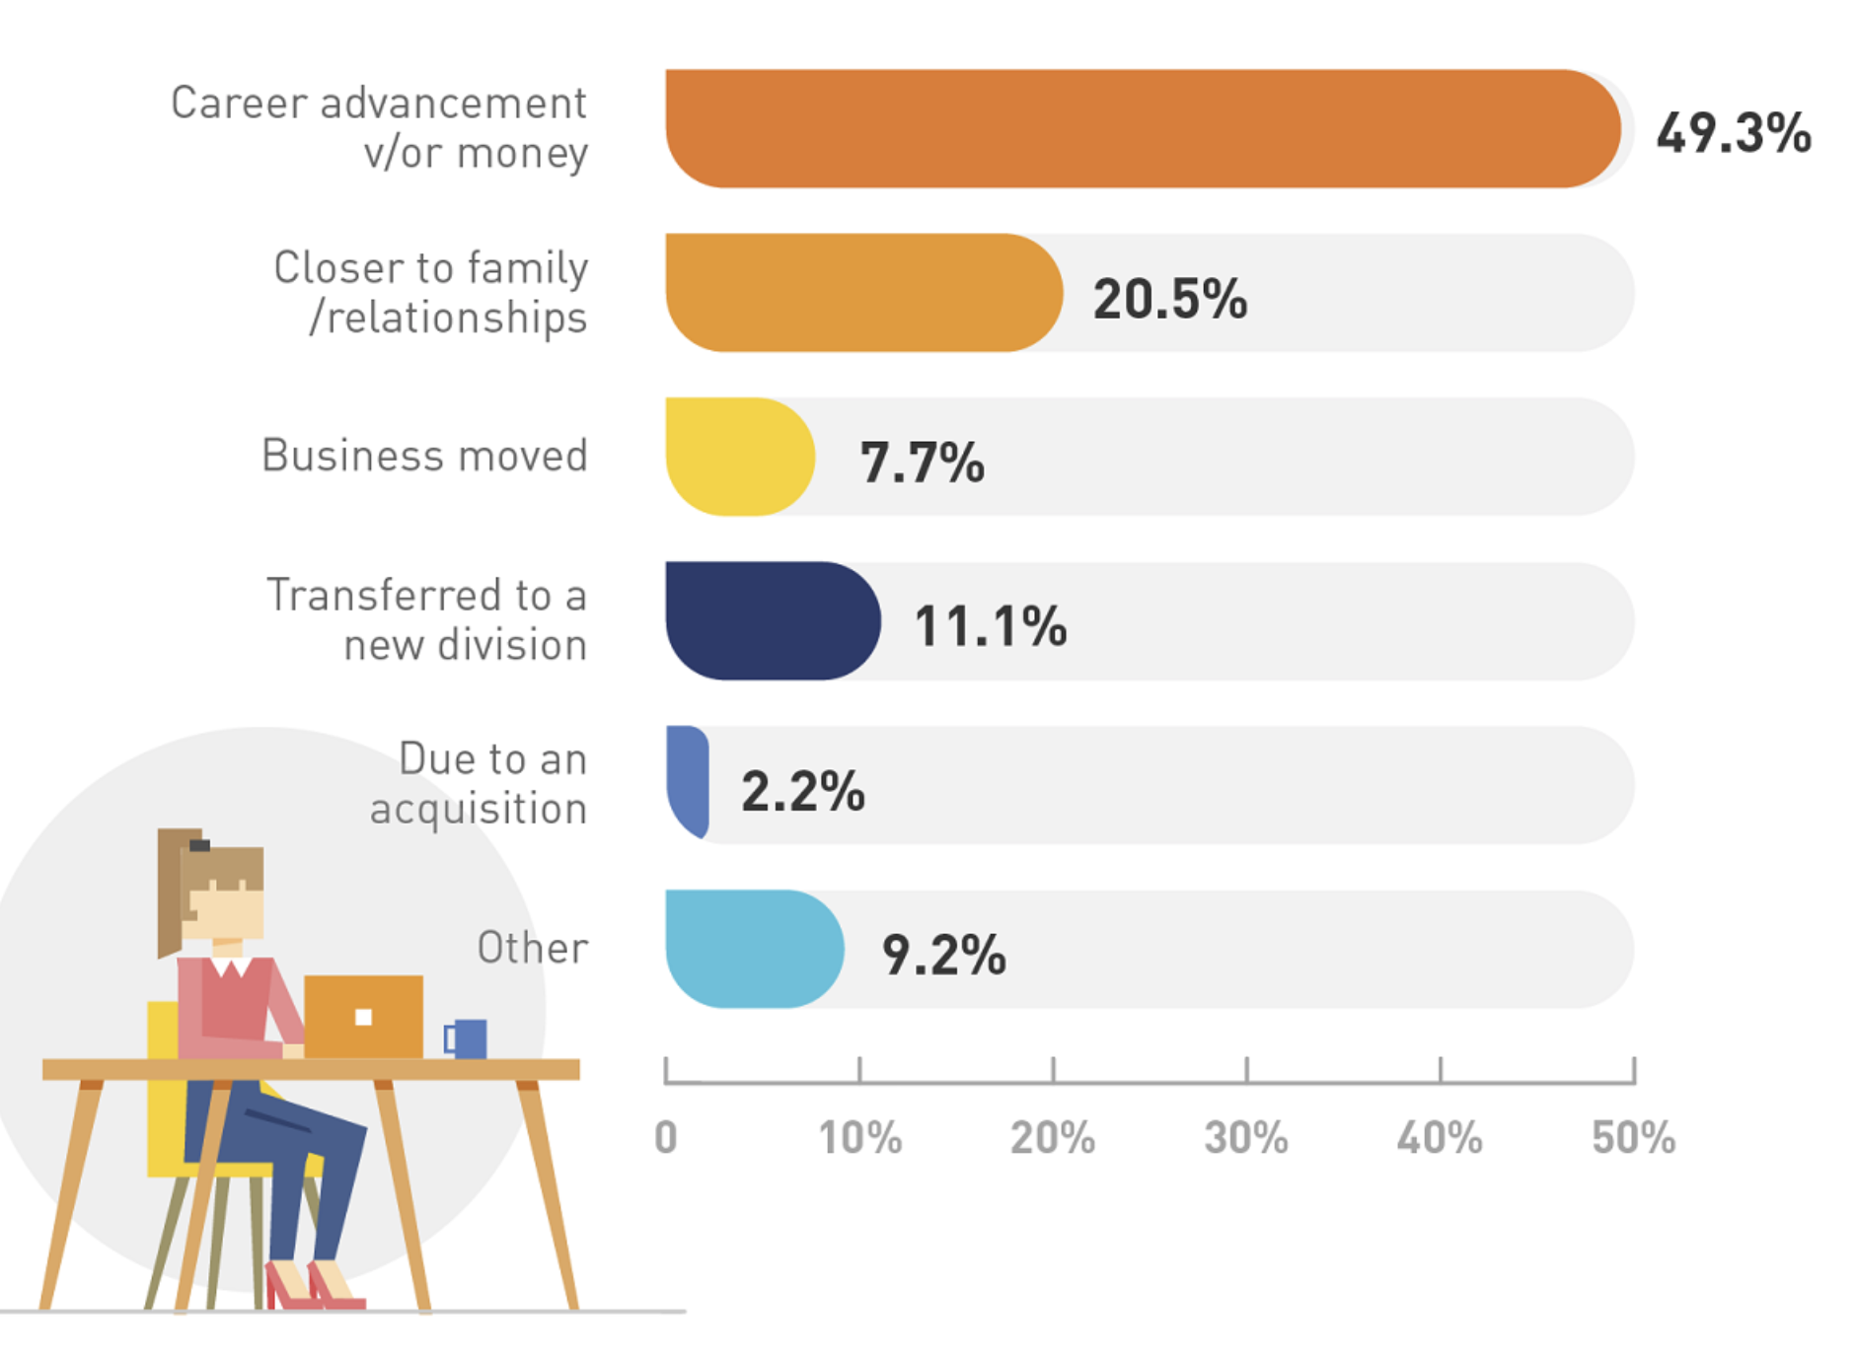
Key Facts
People relocate to seek a higher paying job or career advancement (49.3%)
Find a job closer to family (20.5%).
Transfer within an existing company (11.1%).
Others moved because they relocated their business, or their job moved to a new facility (7.7%)

Slide 4


Project Goal
The goal of the project is to build a location recommendation system for job-searchers.
To help job seekers to settle in a tranquil environment that suits their preferences.

Slide 5
Motivation
People are currently considering where to settle based on work availability and living conditions.
Researching job availability, location, payscale and other factors is time consuming
No mechanism for determining a person’s ideal job and settling location

Slide 6
Existing Solution
Current Solution
Many websites such as glass door , levels fyi predicted salaries based on various attributes such as location , job roles ,years of experience and so on.
But no one predicted location based on the individual's preference.
The mechanism to predict the location based
on the livability condition, PayScale, experience.
Helps in finding better location to settle.
Moreover, the location prediction model greatly cuts down the time spent and provides focal points of research.

Slide 7


Deliverables
LOCATION RECOMMENDATION SYSTEM USING MACHINE LEARNING MODELS
UI FOR JOB-SEARCHERS TO FIND A BEST LOCATION FOR BETTER CAREER PROSPECTS.

Slide 8
Literature Survey
The Following works influenced our approach and model selection:
Applying data mining techniques in job recommender system for considering candidate job preferences” (A. Gupta and D. Garg, 2014)
Job suggestion based on content-based matching and candidate preference
Decision tree which yields 92% accuracy
“Job Prediction: From Deep Neural Network Models to Applications” (Huynh, Nguyen, Nguyen, Nguyen, 2020)
Job prediction using several deep neural network models with various pre-trained word embeddings
Ensemble model with F1-score of 72.71
“A Smart Geo-Location Job Recommender System” (Mughaid, Obeidat, Hawashin, et al., 2019)
Job recommendation system using social media data
Naive Bayes, Support Vector Machine, Random Forest models with 77.04% accuracy
“User Click Prediction for Personalized Job Recommendation” (Jiang, M., Fang, Y., Xie, H. et al, 2019)
Click behavior prediction of job seekers on job search engines
Expectation-Maximization model
“A Job Recommendation Machine Learning Model Using Elderly Lifestyles” (Sithiponporn, Tanlamai, Chandrachai, et al., 2020)
Employment suggestion system for elderly based on their background, habits, and other factors
Logistic regression model with 91.20% accuracy

Slide 9
Project Organization

Slide 10
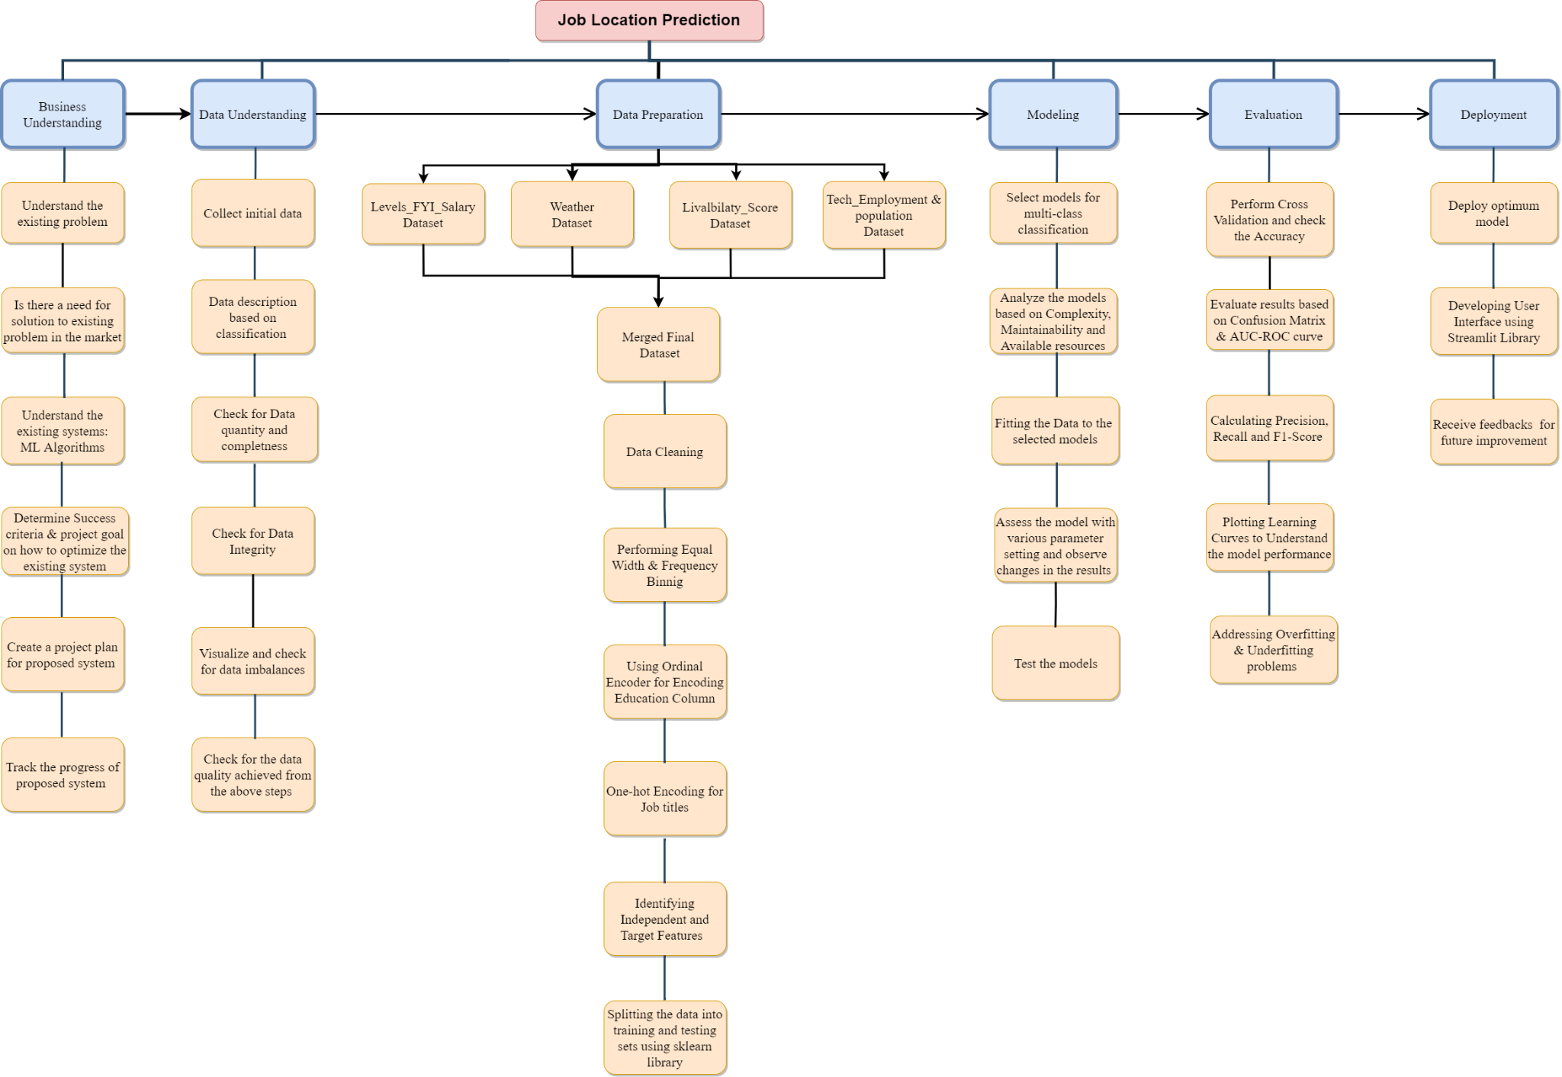
Work Breakdown Structure

Slide 11
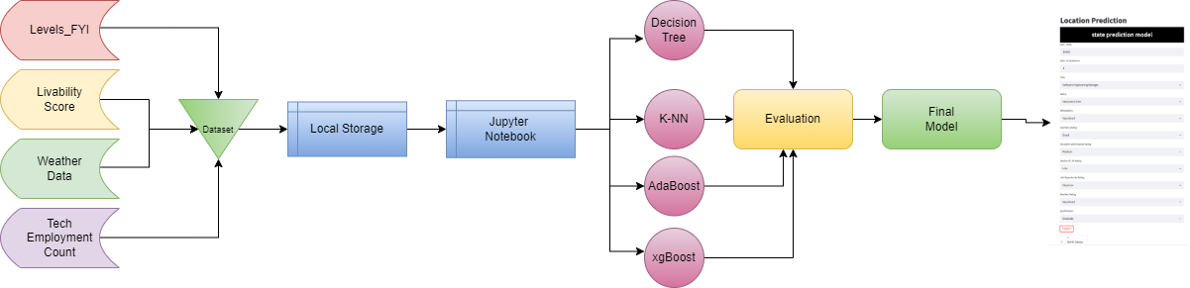
Project Overview

Slide 12

Data Collection
Levels_FYI
Contains information regarding job postings (salary, location, title, etc.)
Livability_Score
States’ rankings based on affordability, economy, cost of living, etc.
Weather_Data
Average daily temperature and rank based on other factors
Tech_Employment_Count
Contains each state’s tech workforce amount

Slide 13
Data Description
The raw datasets were acquired from reputable sources and are treated as accurate, complete, and reliable
Levels.fyi requires verification before posting salary information
Weather, livability, and tech employment data were gathered from National Centers for Environmental Information, Bureau of Labor Statistics, and Economist Intelligence Unit respectively

Slide 14
Data Preparation
The raw datasets require processing before they can be be fed into the model
The four datasets must be combined into one cohesive dataset
City, state, and country values must be separated
There are data points outside the scope of the objective only looking at US states.
Three states - Alaska, South Dakota, Wyoming - did not have tech employment data and are excluded from the dataset
Columns must be renamed to appropriate names

Slide 15
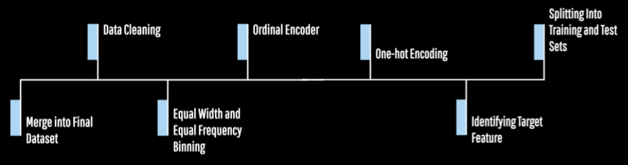
Data Preprocessing

Slide 16
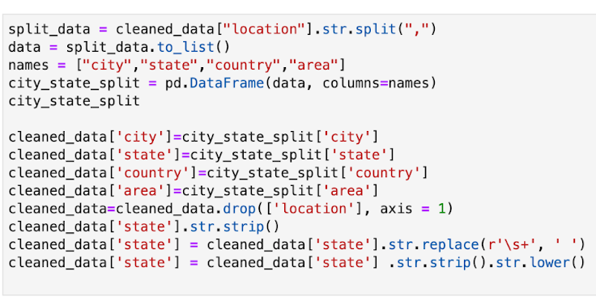
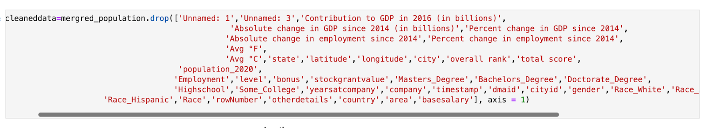
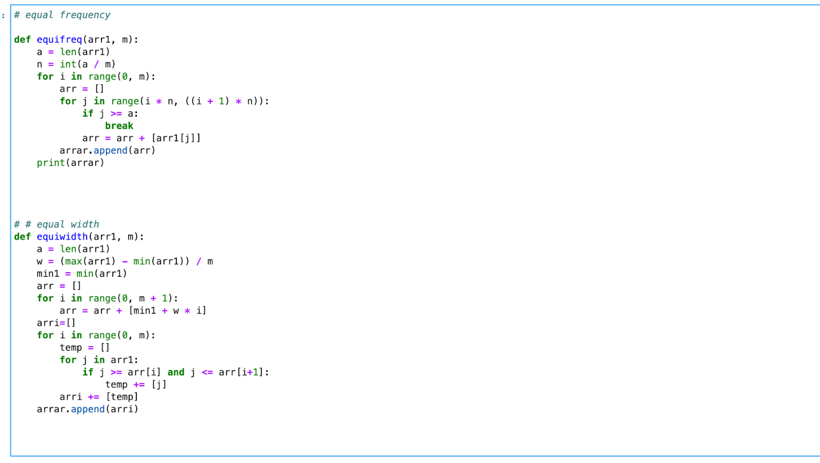
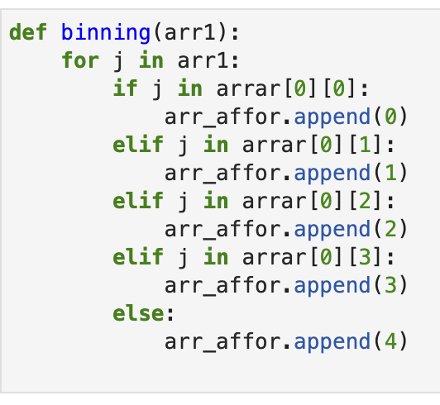
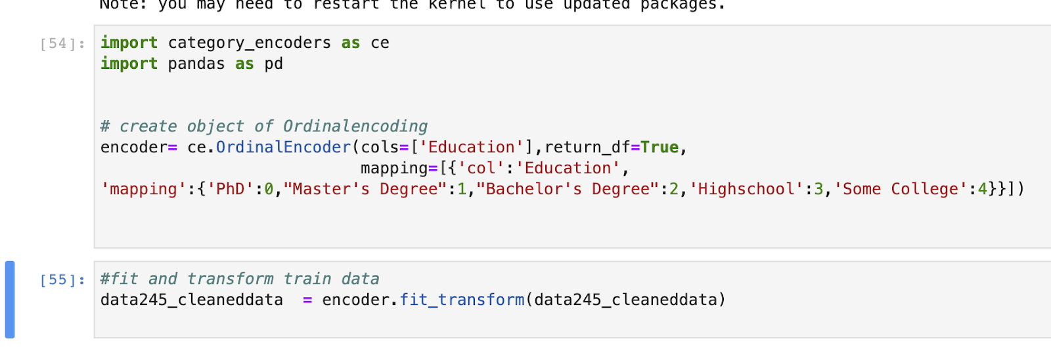
Data Processing Source Code

Slide 17
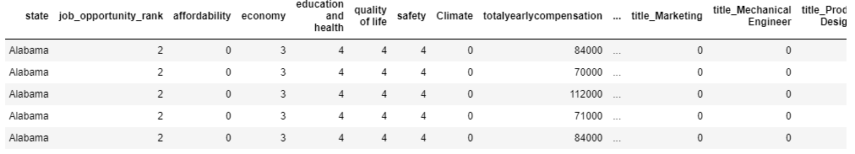
Data Processing cont…
One combined dataset of relevant data points
No missing values
Categorical values encoded to numerical values
Numerical values binned

Slide 18
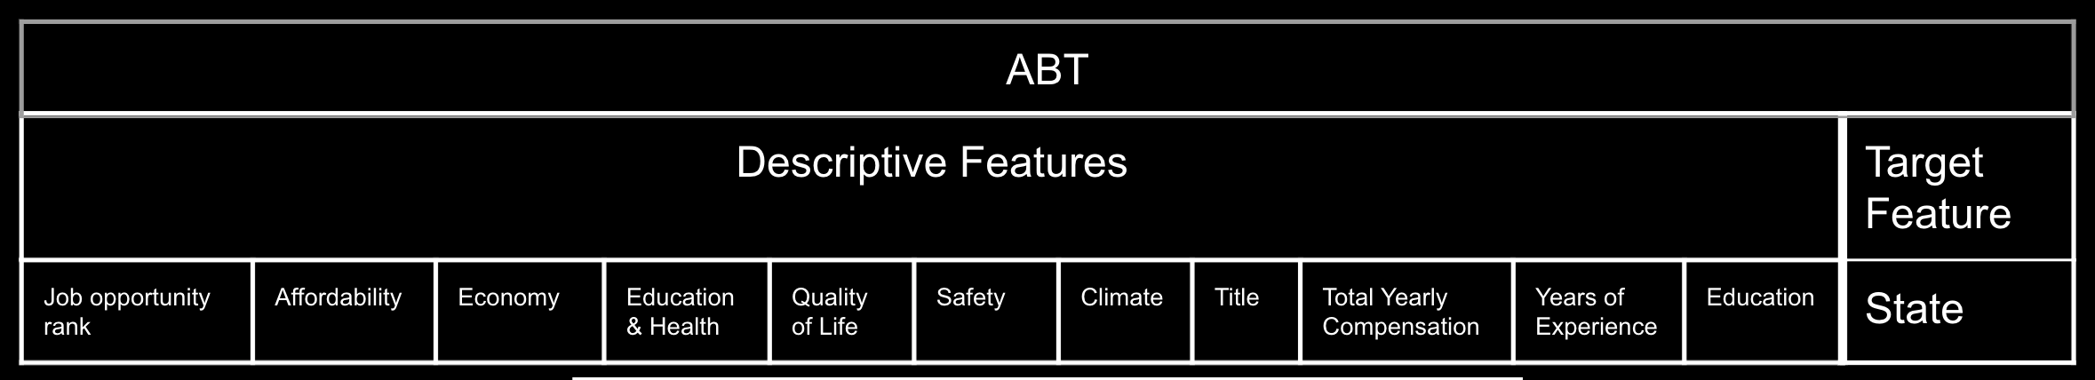
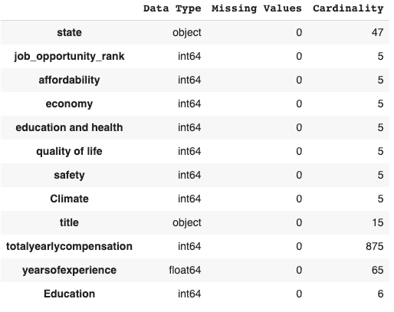
Analytical Base Table & Data Quality Report

Slide 19

Training and Testing Dataset
As our dataset has imbalanced target feature, we used stratified technique to split training and testing dataset to build the ML model.
Also, to validate the built model stratified K-fold cross validation was used.

Slide 20
MODELS

Slide 21
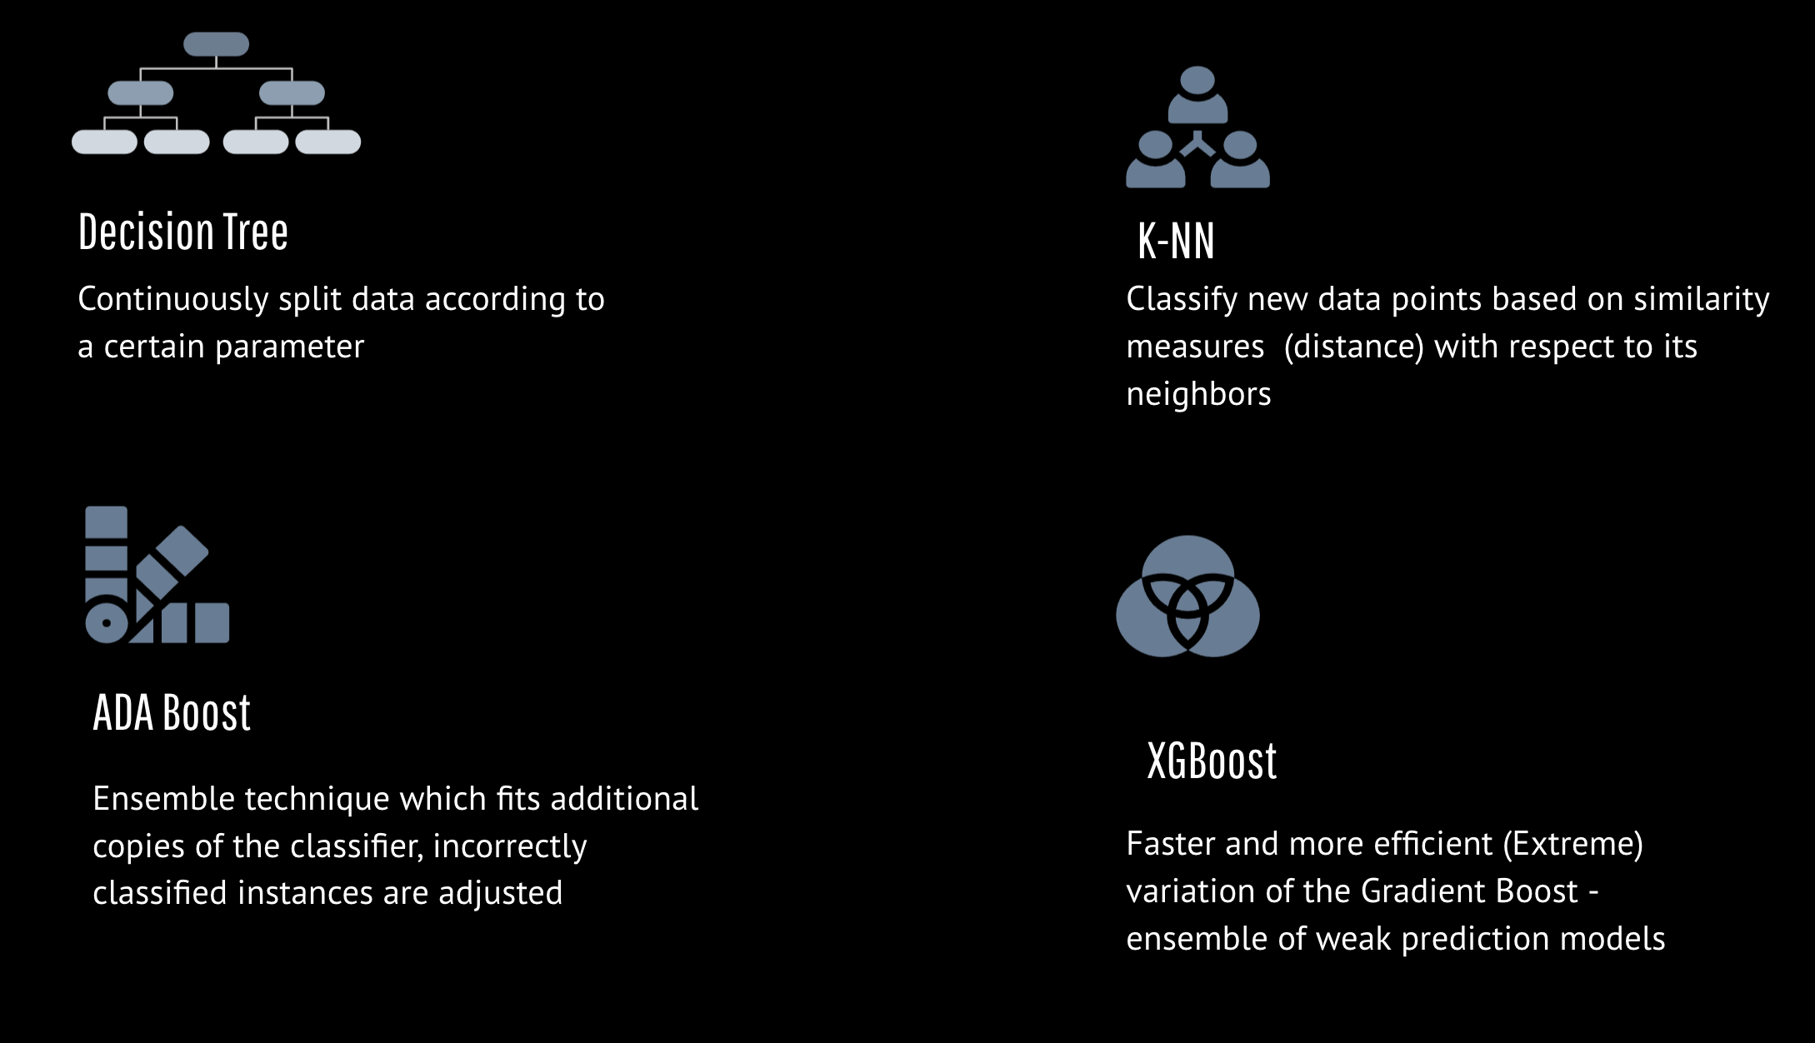

Slide 22
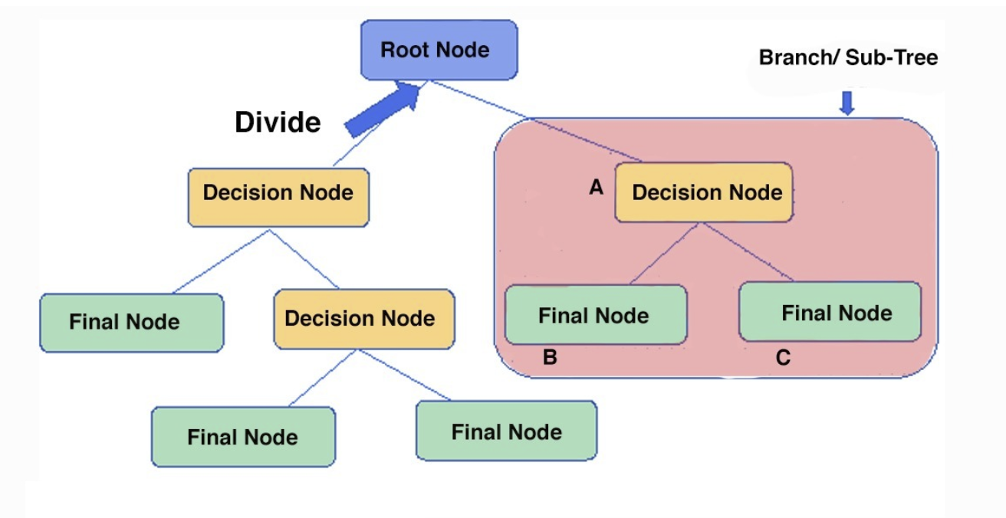
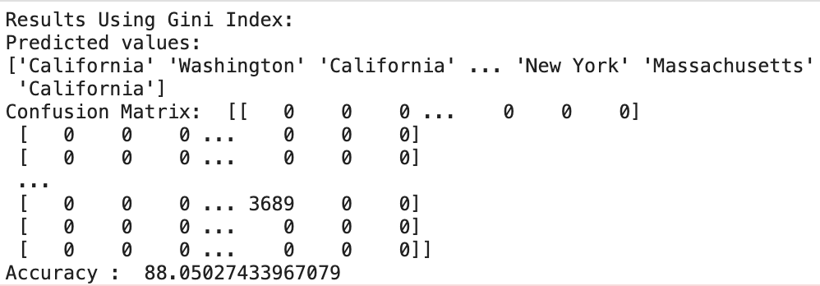
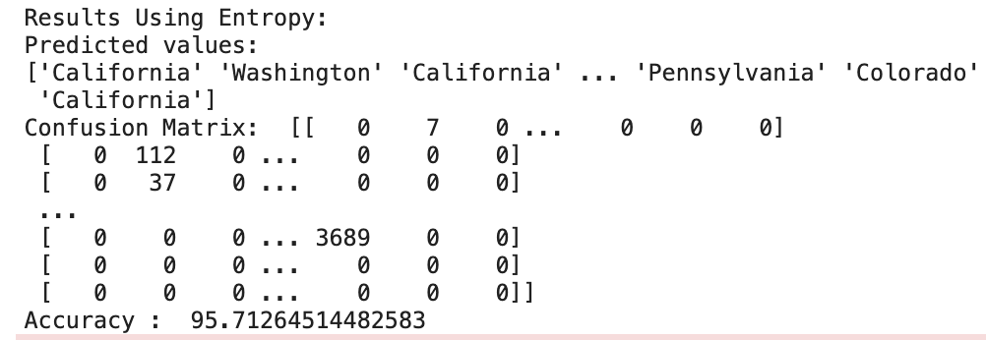
Decision Tree

Slide 23
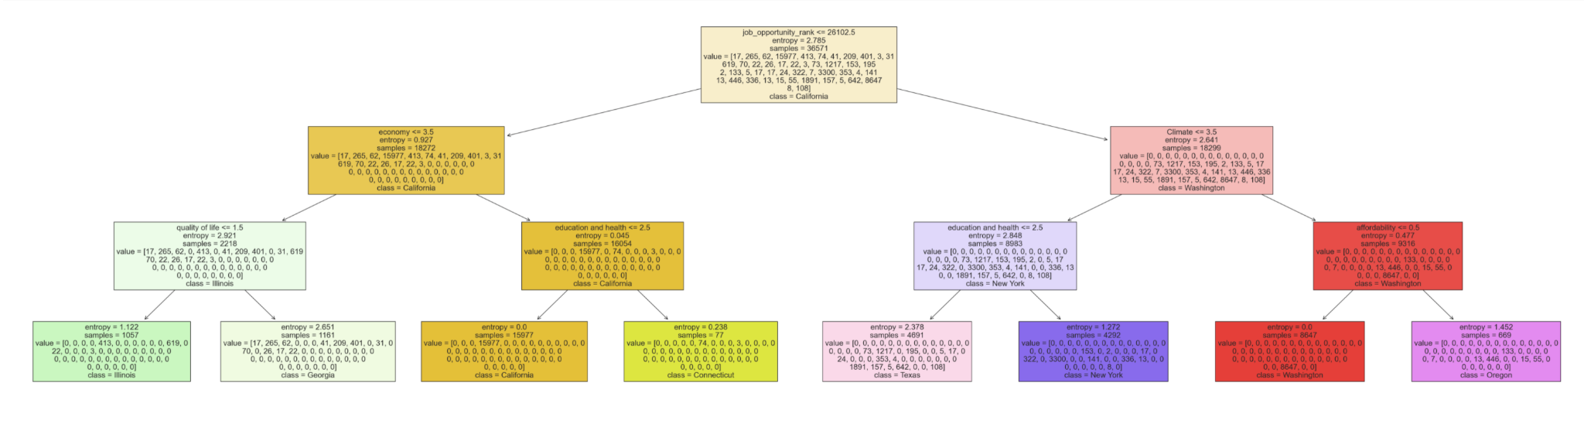
Decision Tree cont..

Slide 24
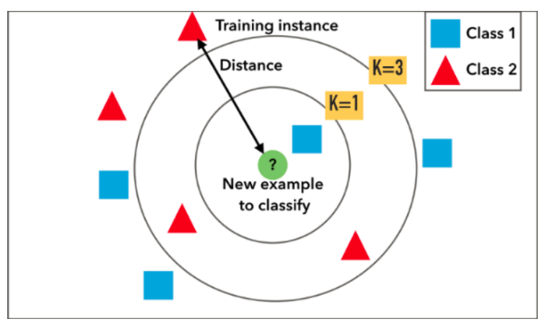
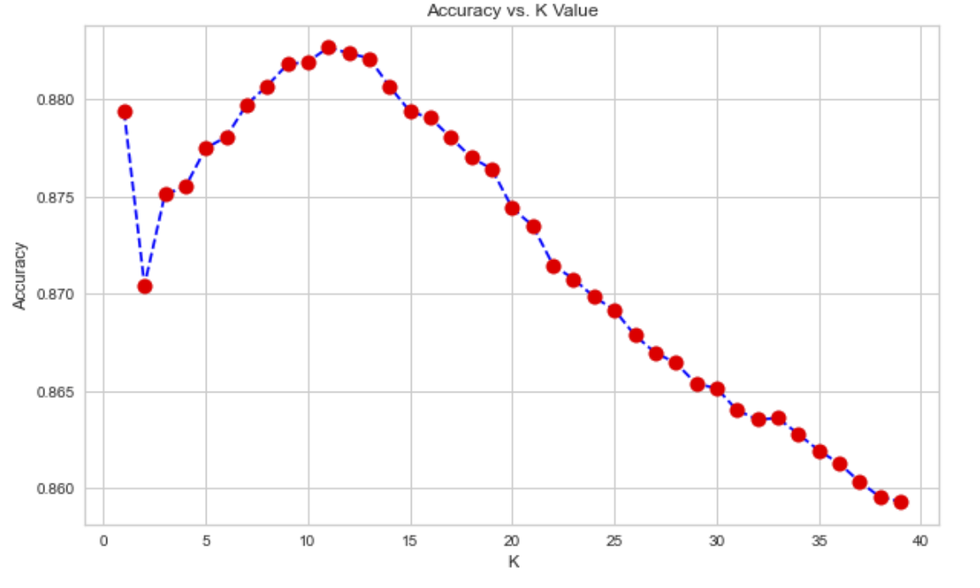
K-Nearest Neighbor

Slide 25
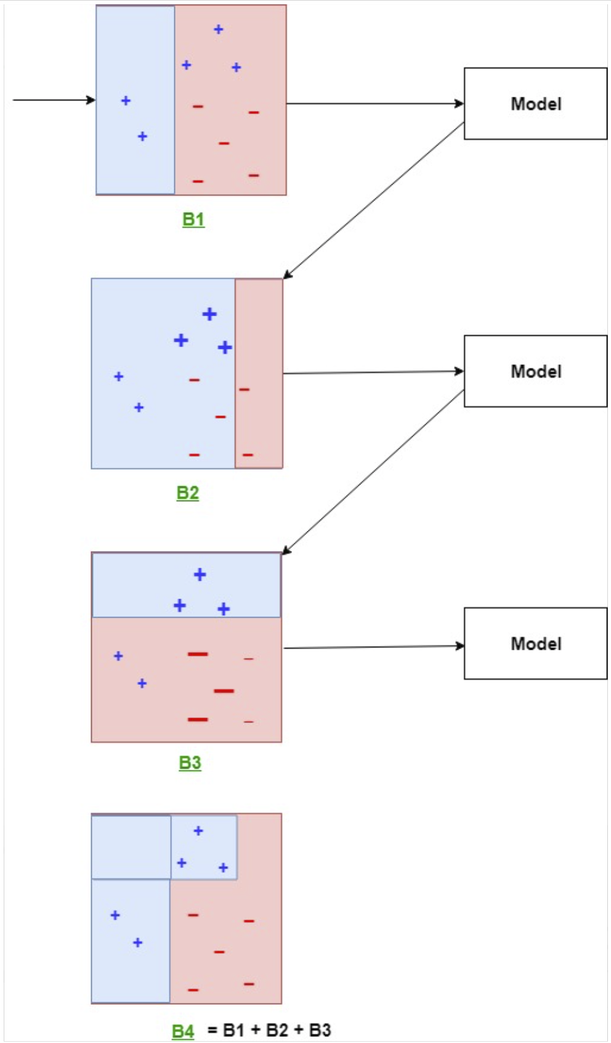
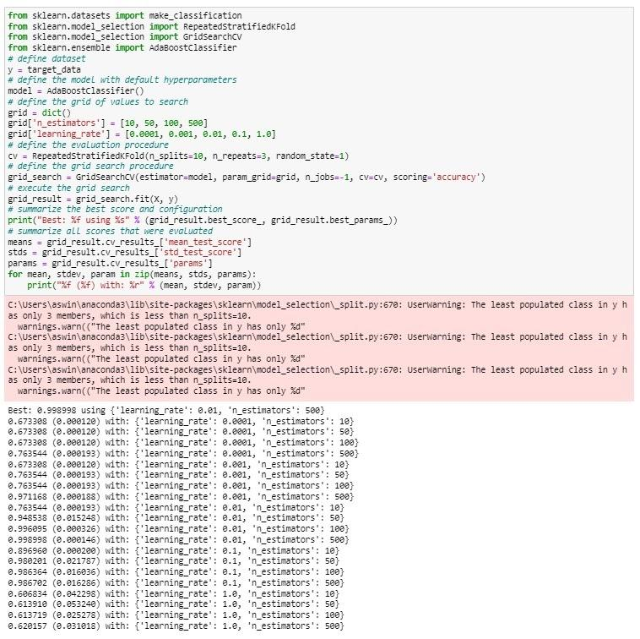
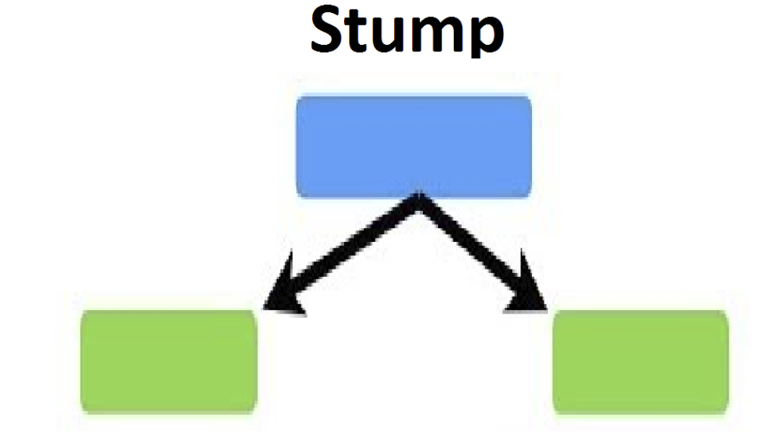
AdaBoost

Slide 26
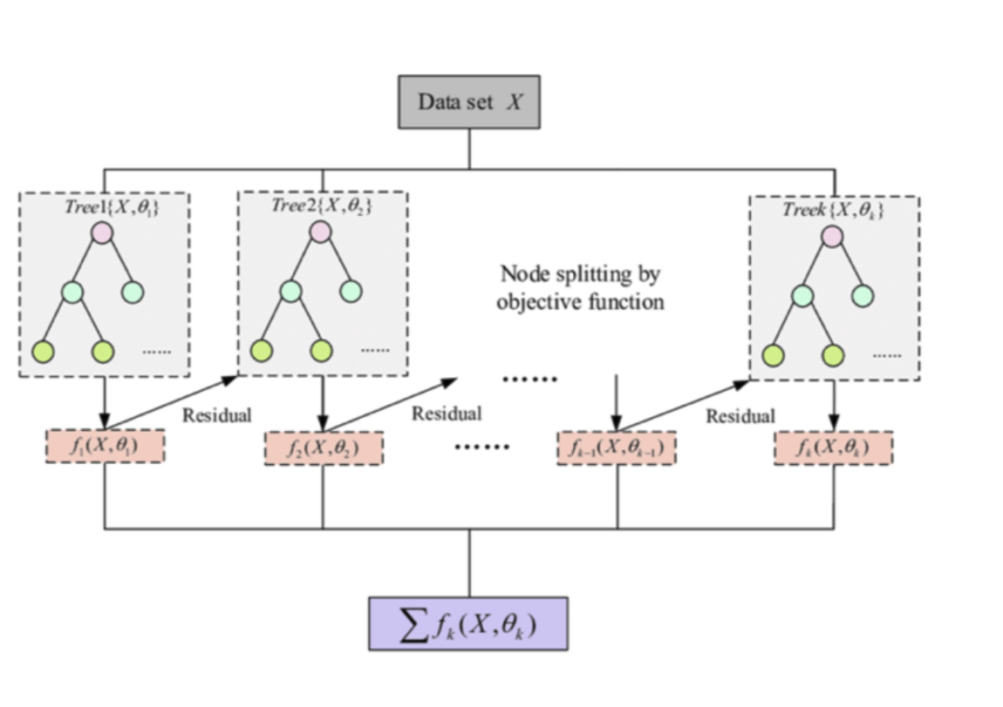
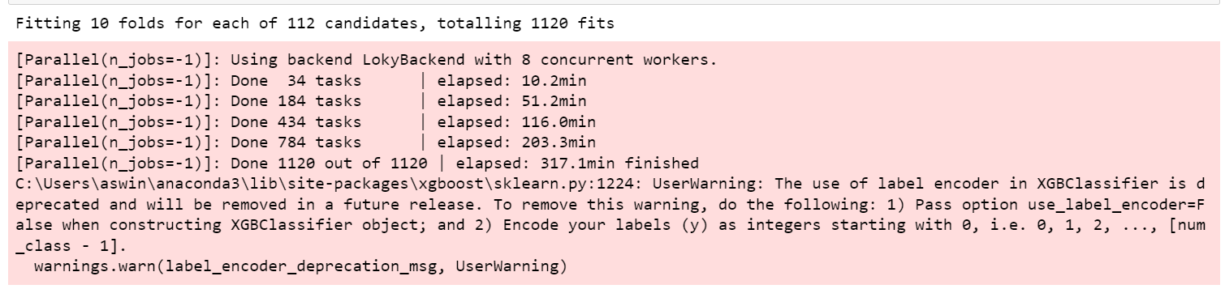
XGBoost

Slide 27
MODEL EVALUATION

Slide 28
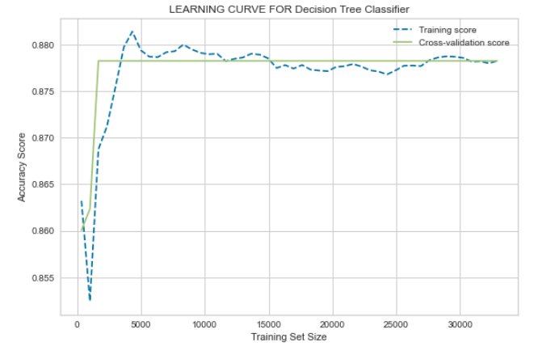
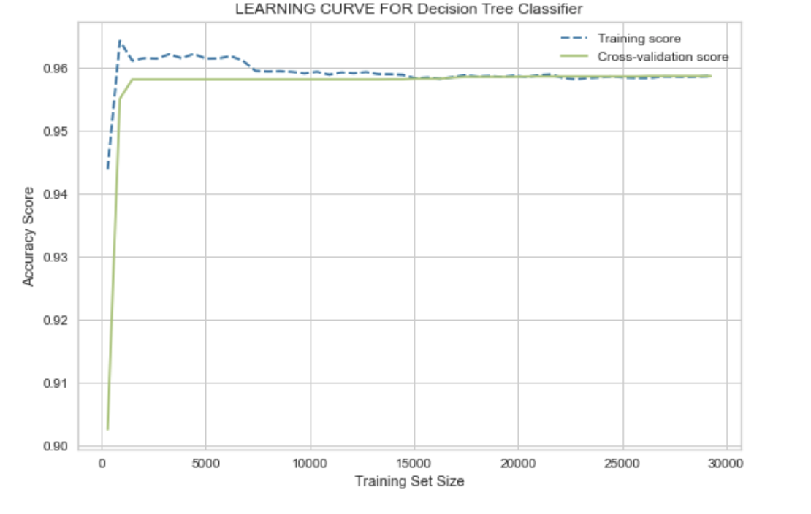
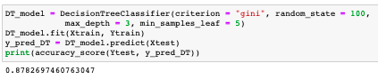
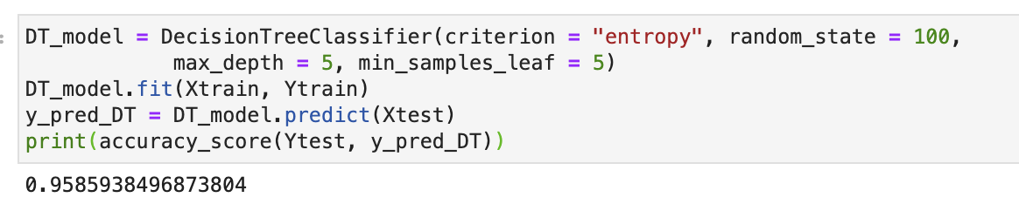
Decision Tree
Before Hyper parameter Tuning
After Hyper parameter Tuning

Slide 29
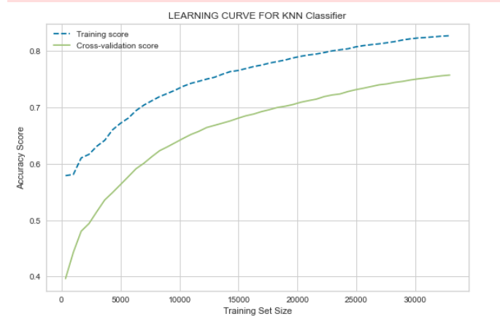
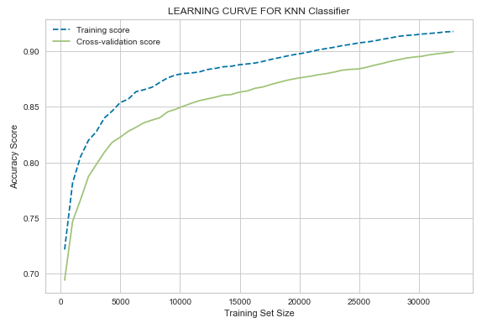
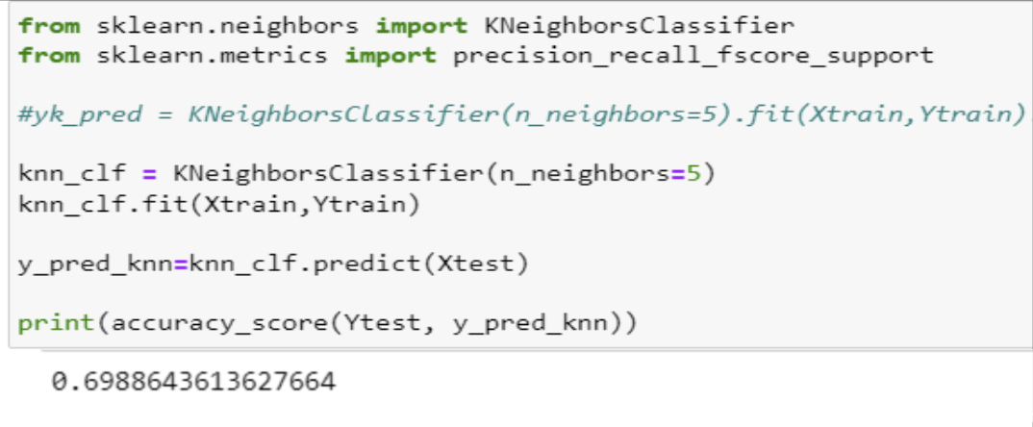
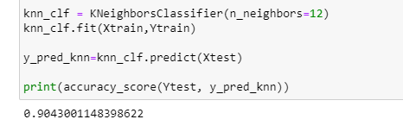
K-Nearest Neighbor
Before Hyper parameter Tuning
Before Hyper parameter Tuning

Slide 30
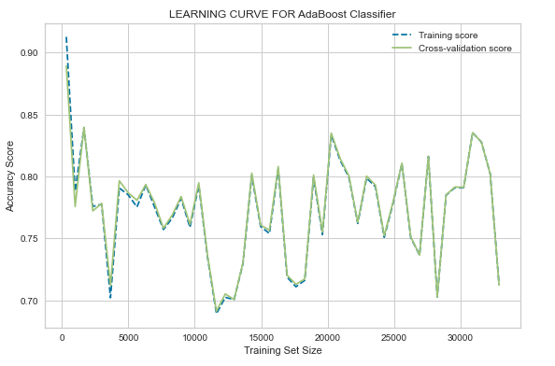
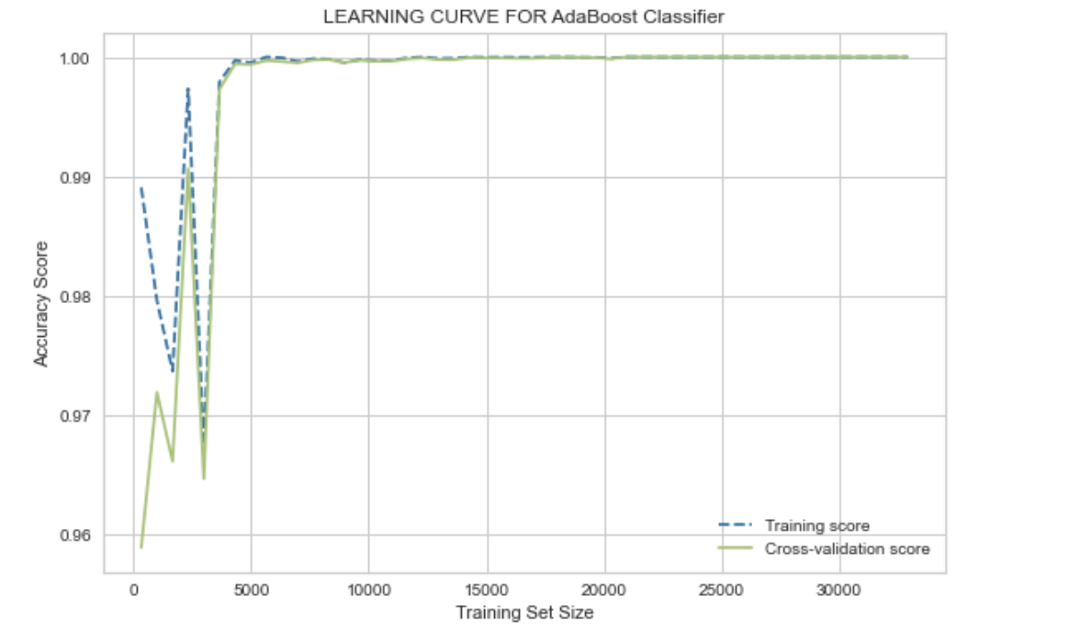
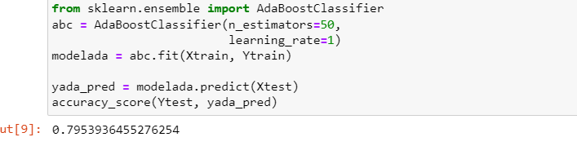
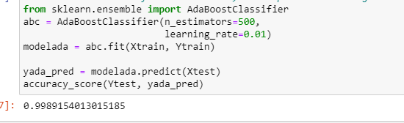
AdaBoost
Before Hyper parameter Tuning
After Hyper parameter Tuning

Slide 31
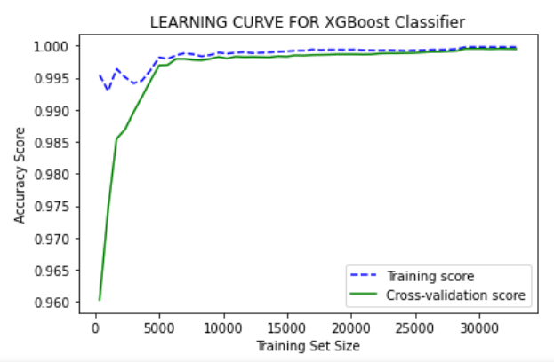
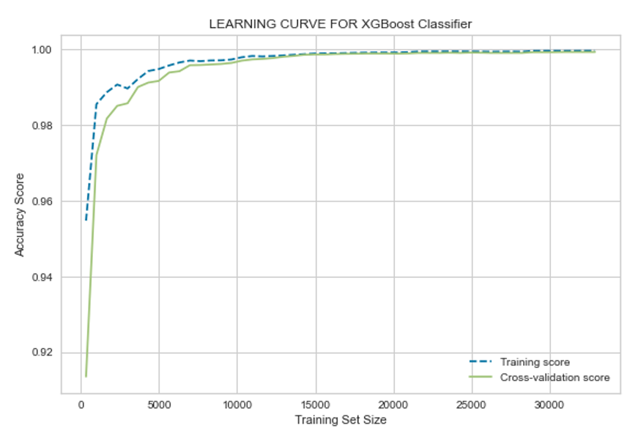
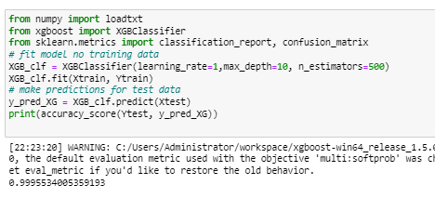
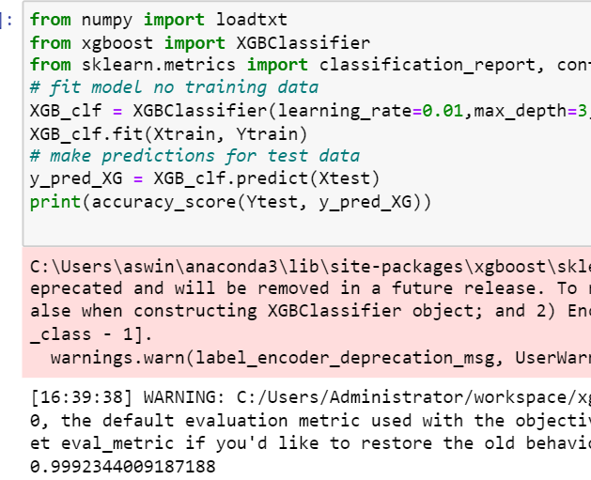
XGBoost
Before Hyper parameter Tuning
After Hyper parameter Tuning

Slide 32
Model Validation and Evaluation
ROC Curve
Calculating Precision, Recall, F1-Score
Calculating Training Accuracy and Testing Accuracy
Stratified 10-fold cross validation

Slide 33
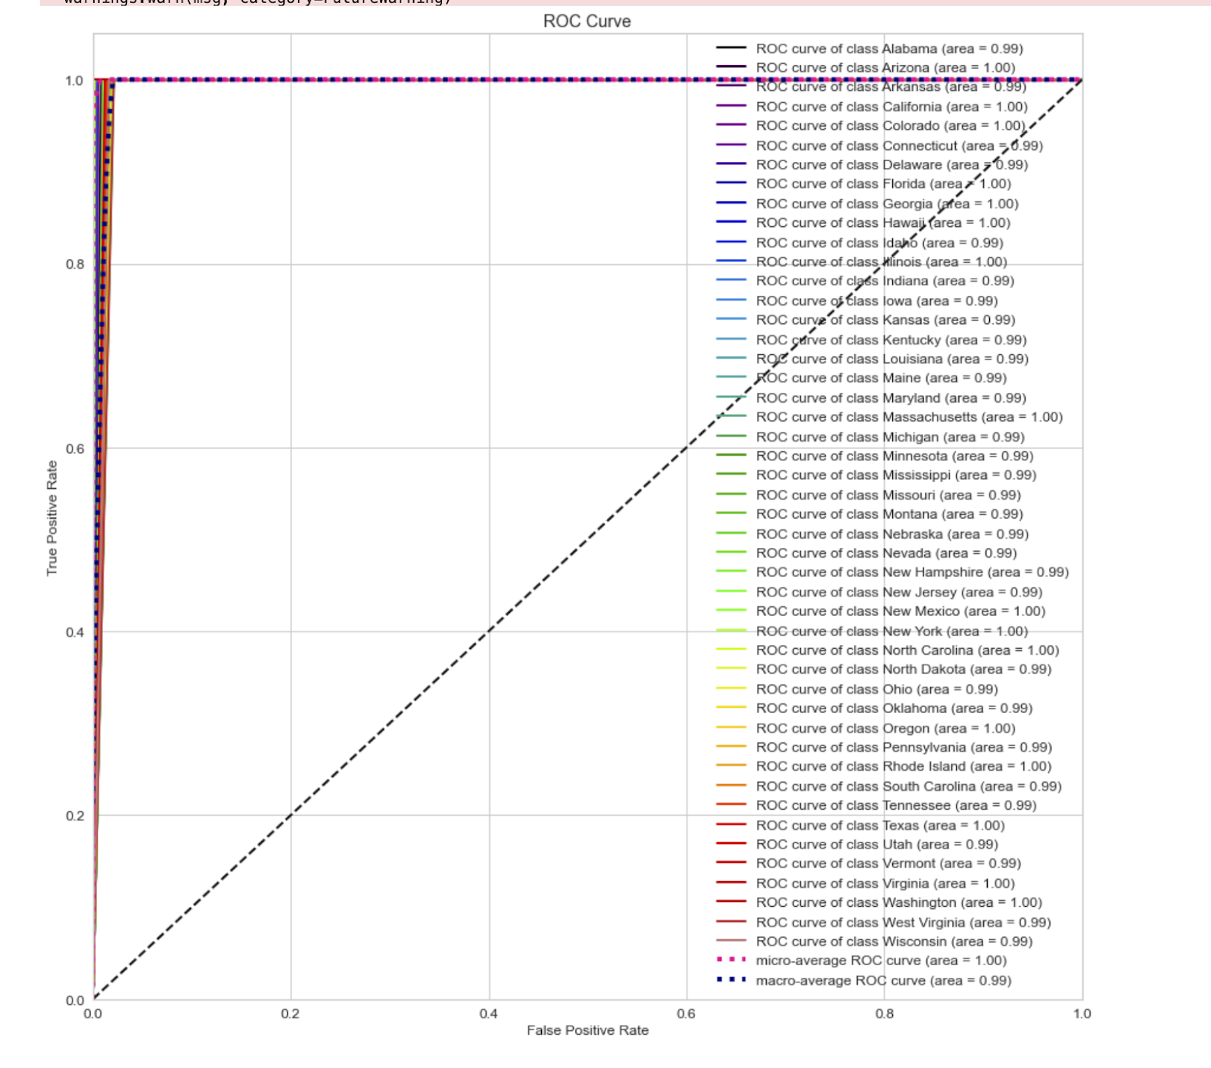
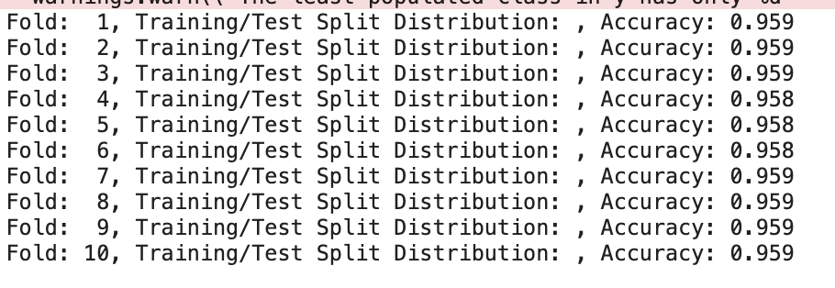
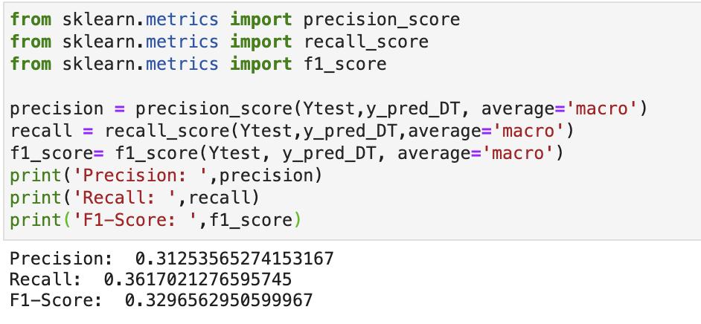
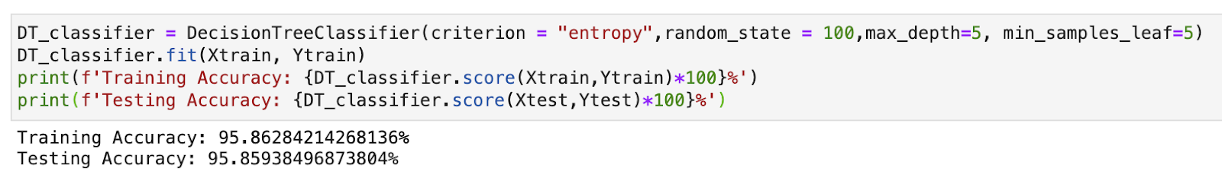
Decision Tree

Slide 34
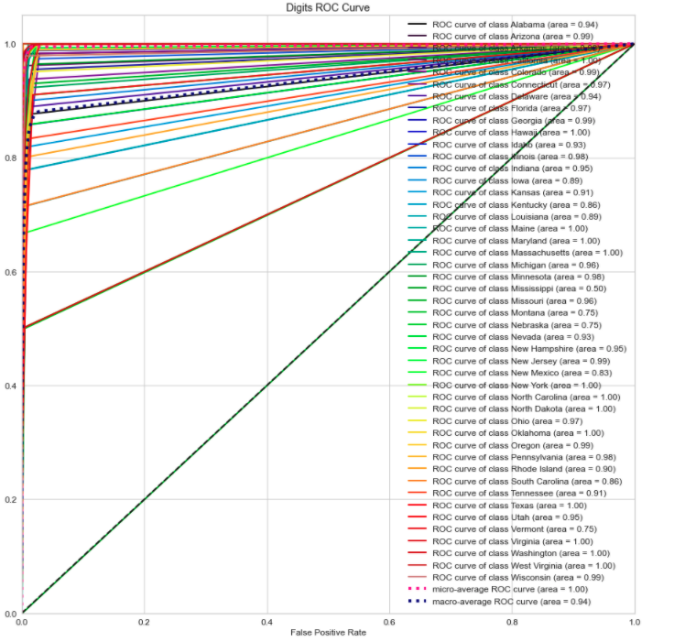
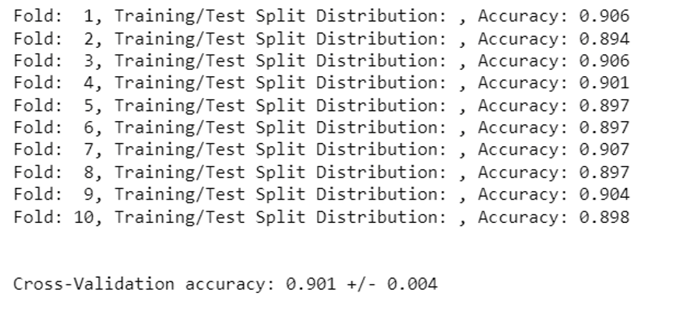
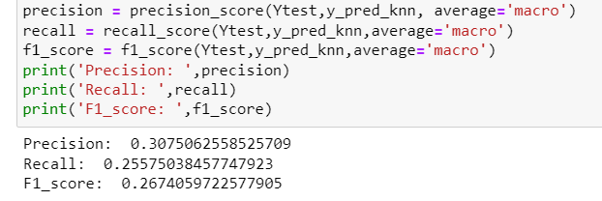
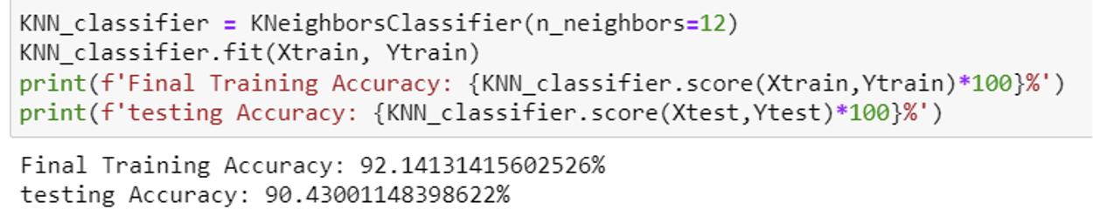
K- Nearest Neighbor

Slide 35
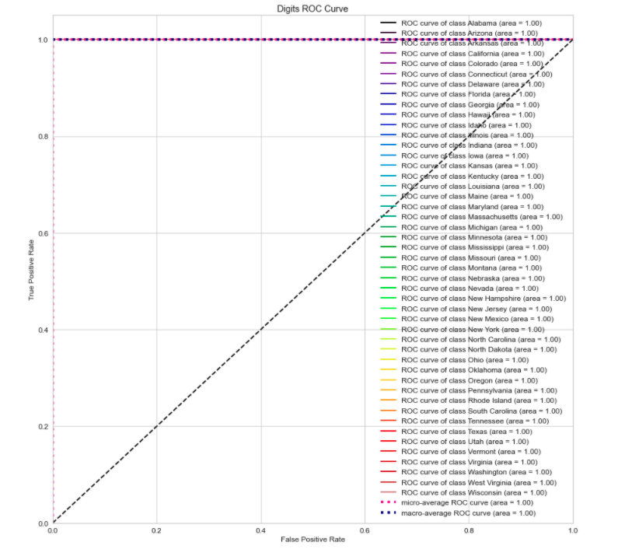
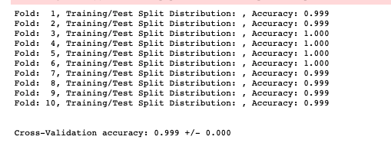


AdaBoost

Slide 36




XgBoost

Slide 37
Model Comparison and Justification
Decision Tree:
Decision Tree achieved accuracy of 95%
Even though it achieved higher accuracy rate precision, recall and f1-score Is very low
Area under curve was less when compared to boosting techniques
K-NN:
K-NN model didn’t perform well
After tuning, this K-NN model was still overfitted
Precision, Recall and F1- Score was very less
XgBoost:
The XgBoost model performed well with a 99.23% accuracy
But Precision, Recall and F1 - Score was less comparing with AdaBoost
AdaBoost:
AdaBoost achieved accuracy rate of 99.89%
AdaBoost has highest True positive rate compare to all other models.

Slide 38
UI DEMO

Slide 39

THANK YOU

